Slide 1
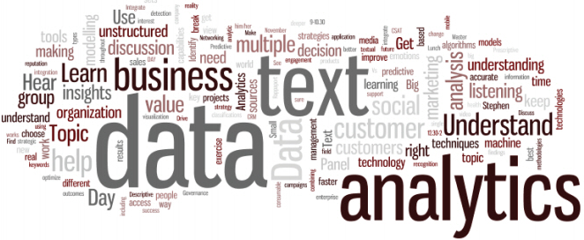
Neti Sheth
Soumya Roy
Zhenlong Wu
Raghav Dasari

Slide 2



Tweets Data Exploration on three US major carriers

Slide 3

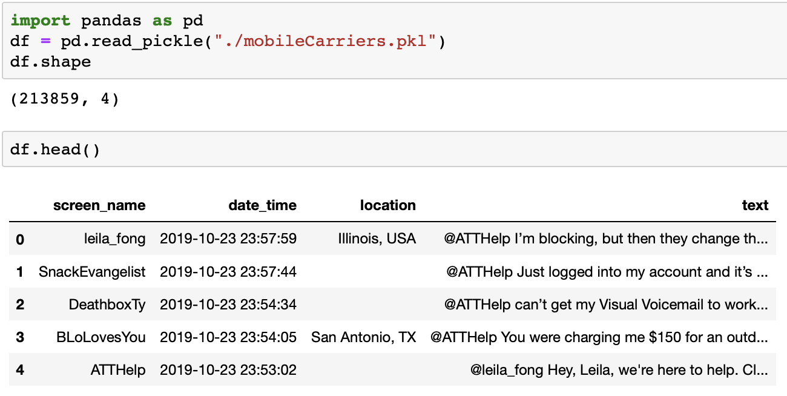
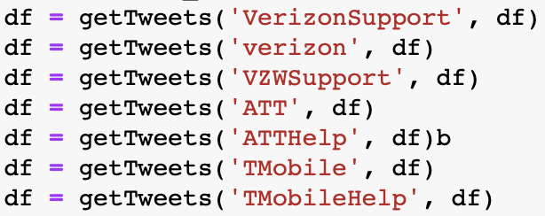
Goal
Through the customer sentiment analysis of the three major Carriers, implement churn detection and find out the reasons for the customer wants to churn.
Data Source: 213859 Tweets so far, from 2019-10-9 to 2019-10-23

Slide 4
Data exploration and visualization
Questions:
How many Tweets are there for the three major operators?
What are most frequent words in each carrier?
How many times have the three major operators been mentioned over time?
Sentiment Analysis:
What is sentiment polarity distribution of each carrier?
What is overall sentiment polarity of each carrier?
Positive tweets vs. Negative tweets of each carrier.
Representative vocabulary in both Positive Tweets and Negative Tweets.

Slide 5
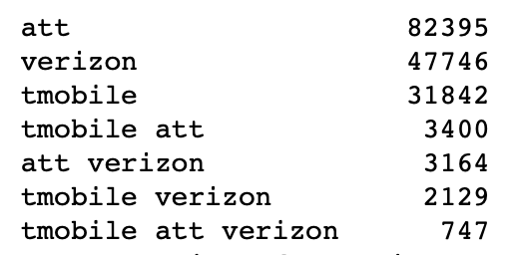
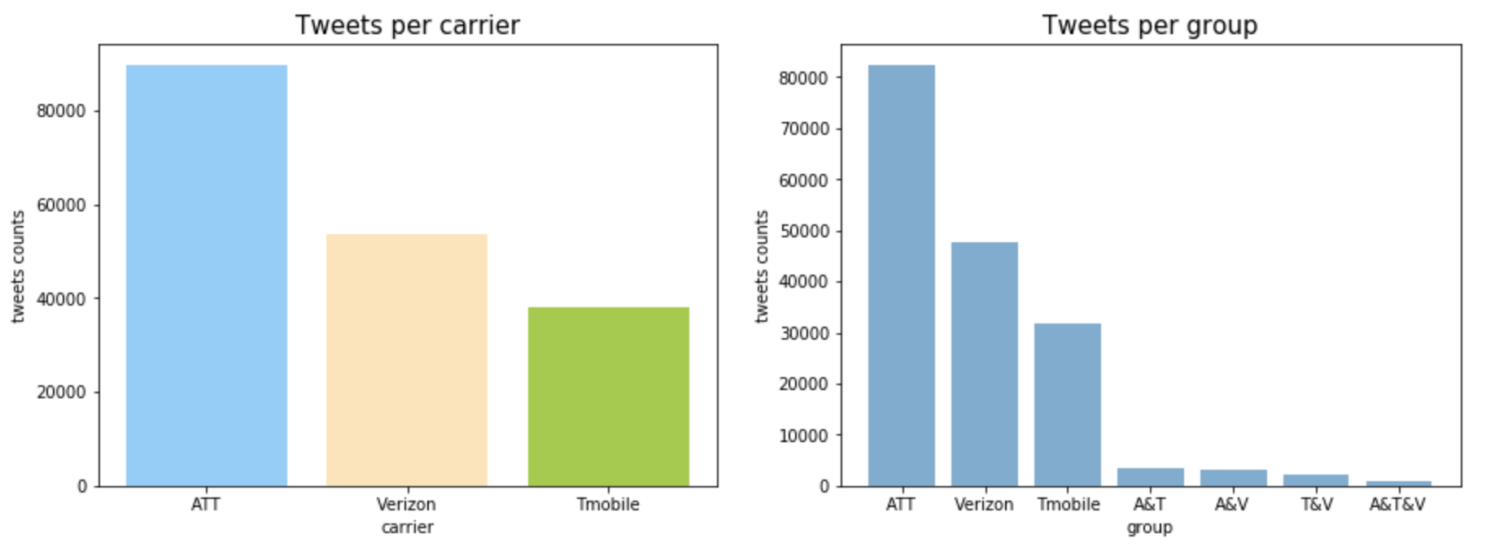
How many Tweets are there for the three major operators?

Slide 6
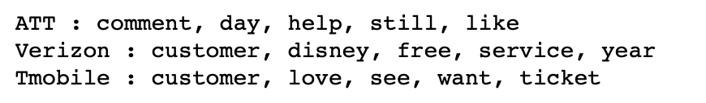
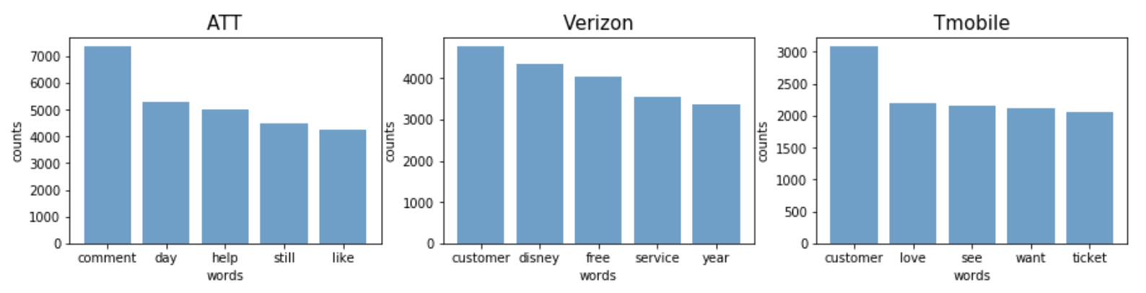
What are most frequent words in each carrier?

Slide 7
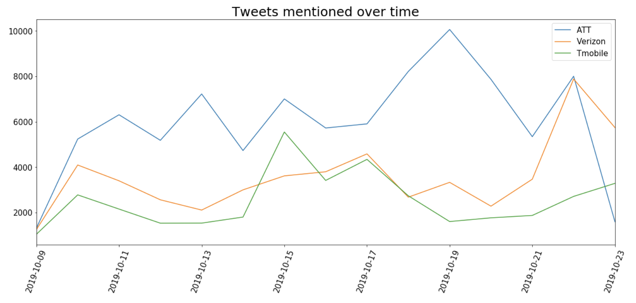
How many times have the three major operators been mentioned over time?

Slide 8
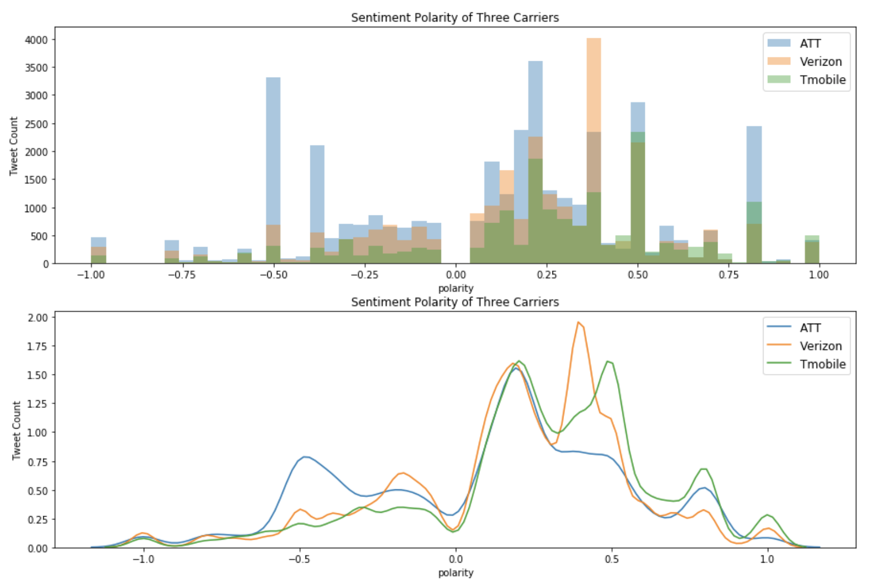
What is sentiment polarity distribution of each carrier?

Slide 9
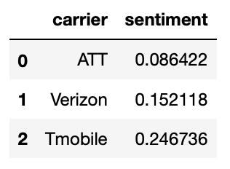
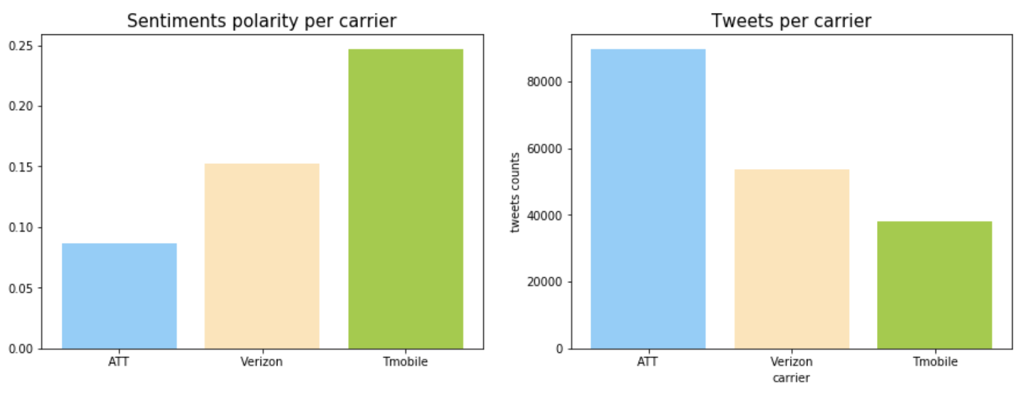
What is overall sentiment polarity of each carrier?

Slide 10
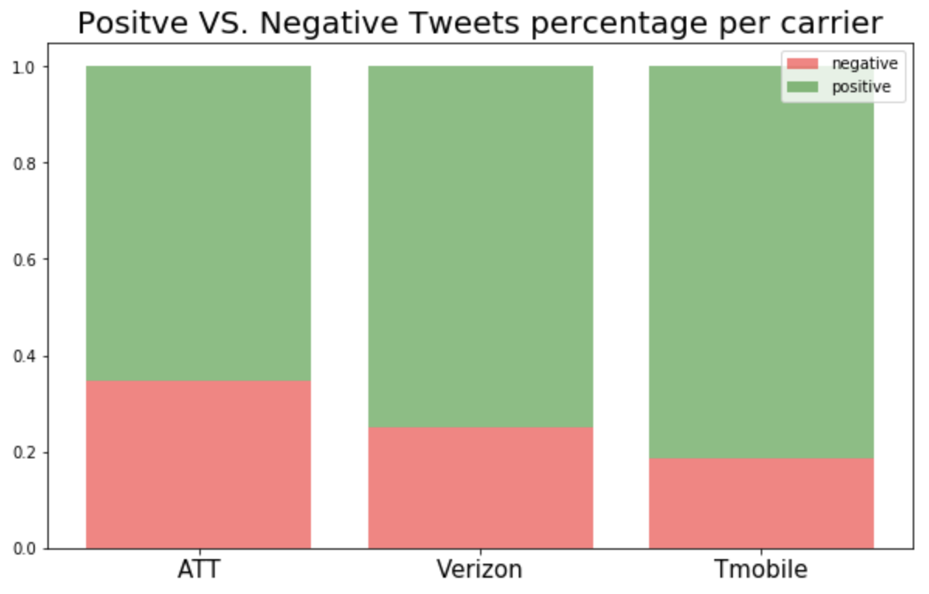
Positive tweets vs. Negative tweets of each carrier.

Slide 11
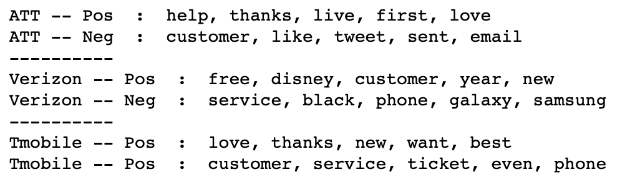
Representative vocabulary in both Positive Tweets and Negative Tweets
Method1: Most Frequent Words:

Slide 12
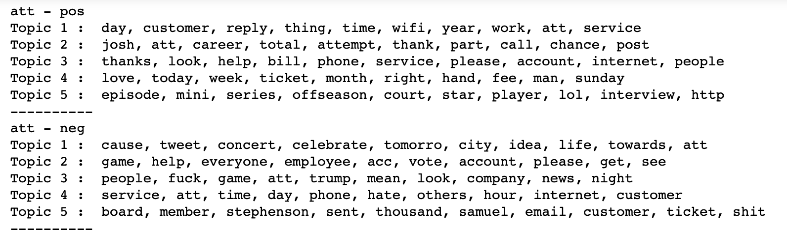
Representative vocabulary in both Positive Tweets and Negative Tweets
Method2: Topic Model Words:

Slide 13
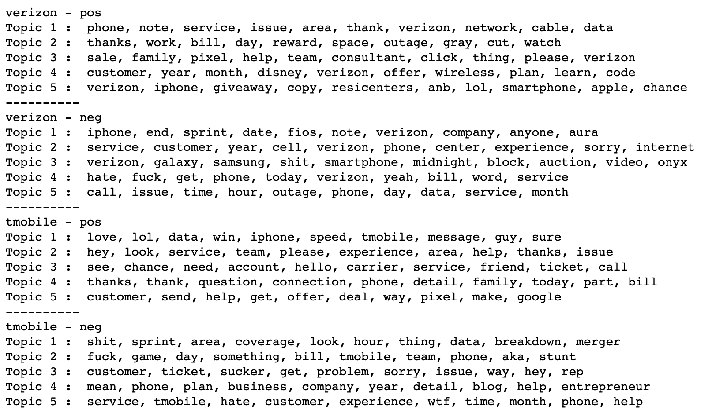
Topic Model Words Contd.

Slide 14
Guess: positive and negative reasons
AT&T Positive: wifi, service...
AT&T Negative: internet, ticket, game...
Verizon Positive: iphone,data...
Verizon Negative: samsung, bill, outage...
T-Mobile Positive: family, speed, offer...
T-Mobile Negative: coverage, service...

Slide 15
Thank you!

